Slide 1

Cofster: Architectural Framework for an Intelligent Coffee System Using CV and NLP
Authors: Darie-Teofil Glanda
Scientific supervisor: Razvan Bogdan

Slide 2
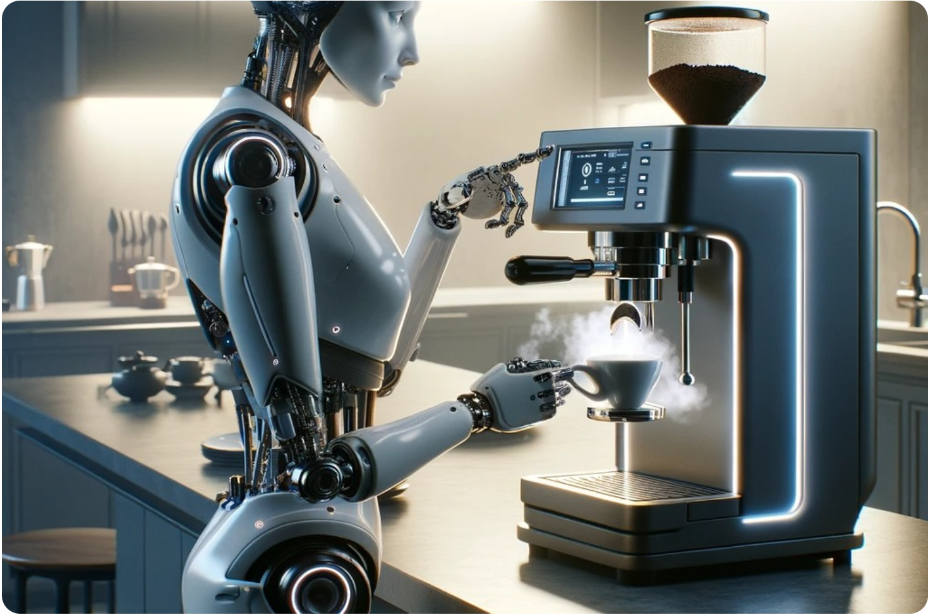
Research Question

Slide 3
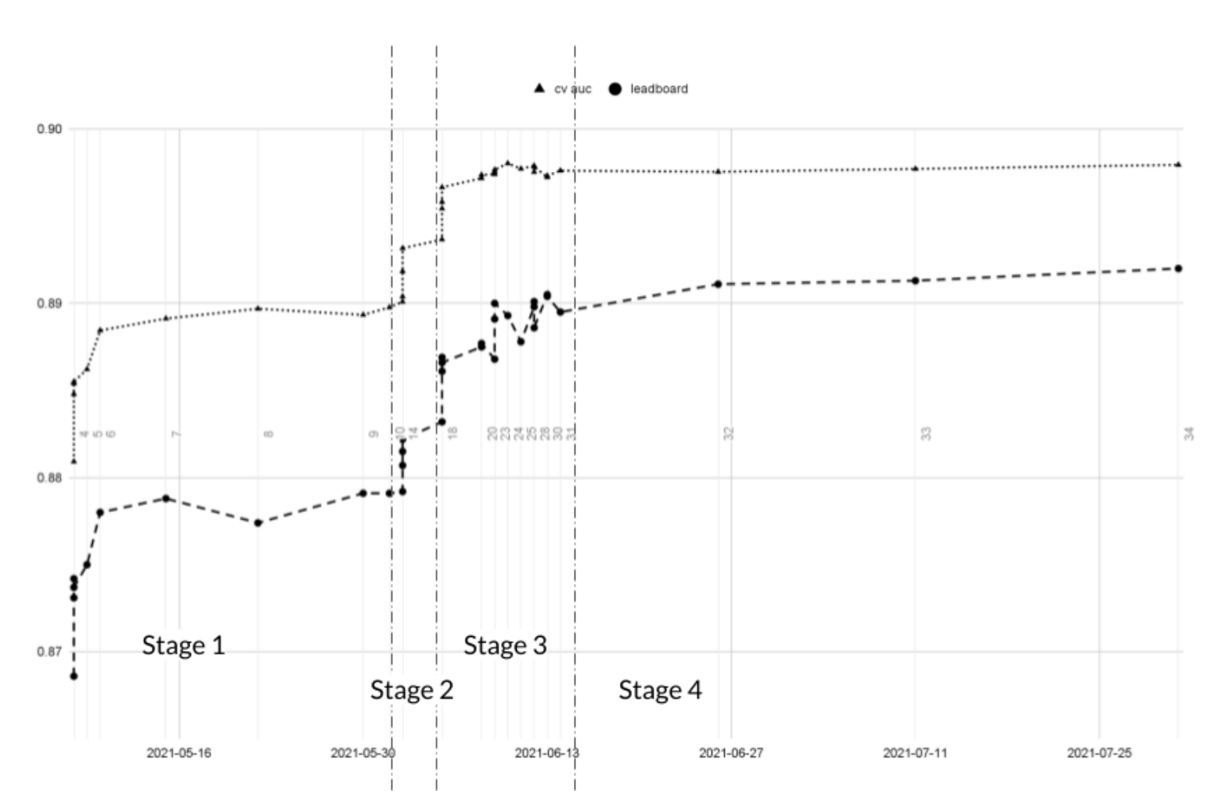
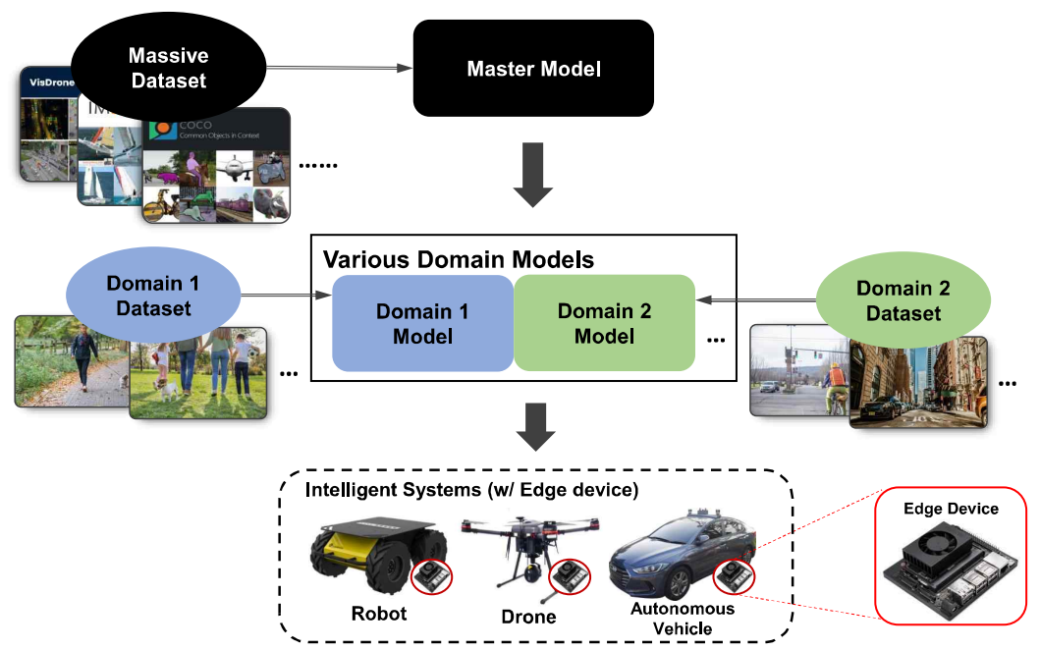
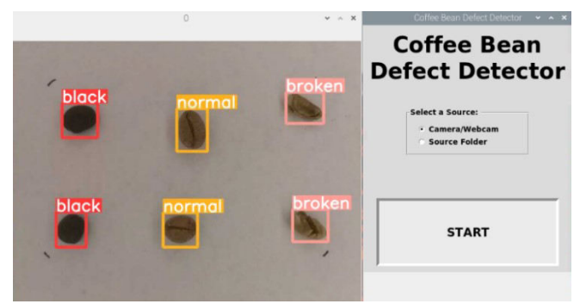
Related Work
Predicting Victories in Video Games: Using Single XGBoost with Feature Engineering [2]
Real-time object detection using a domain-based transfer learning method for resource-constrained edge devices [1]
Classification of Defects in Robusta Green Coffee Beans Using YOLO [3]

Slide 4
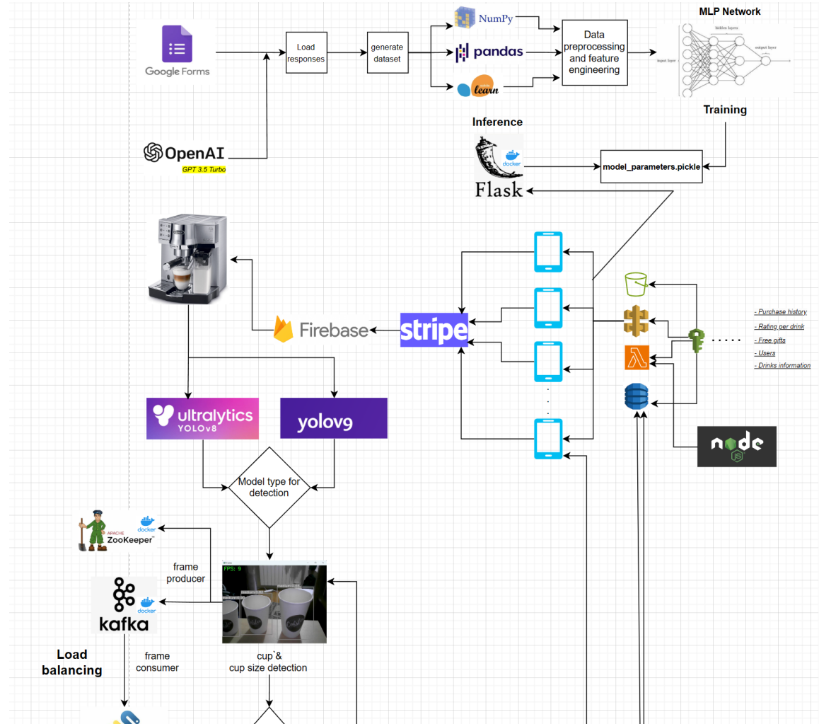
Cofster
Architecture

Slide 5
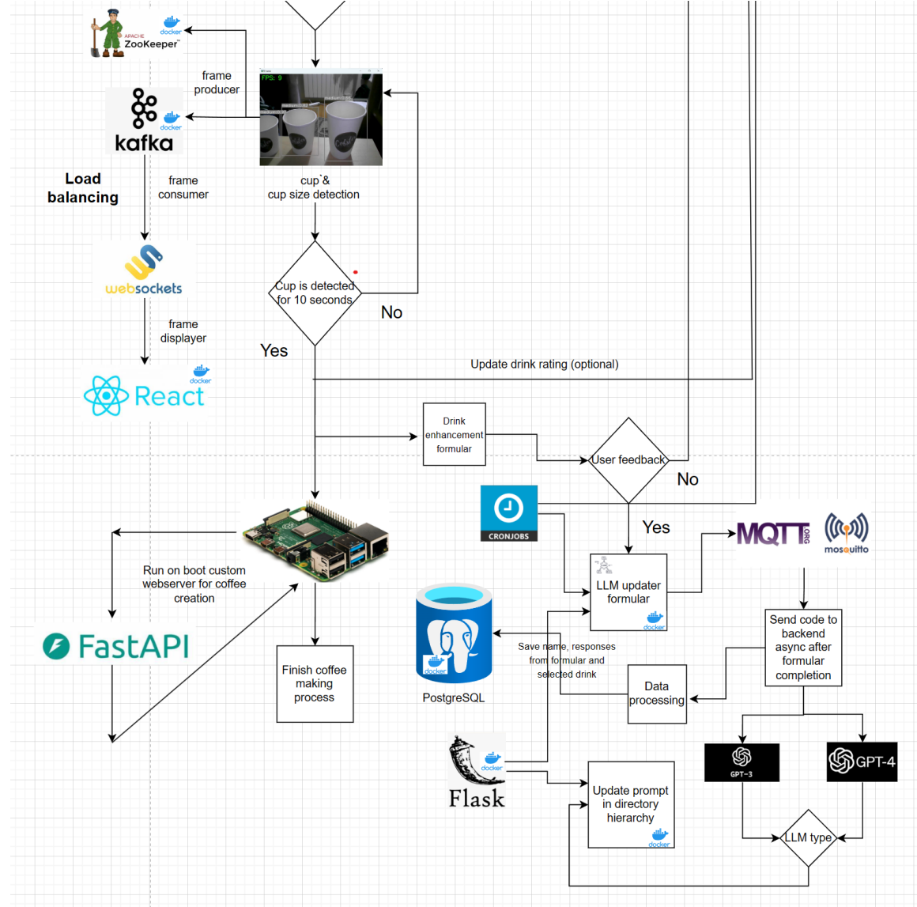
Cofster
Architecture

Slide 6
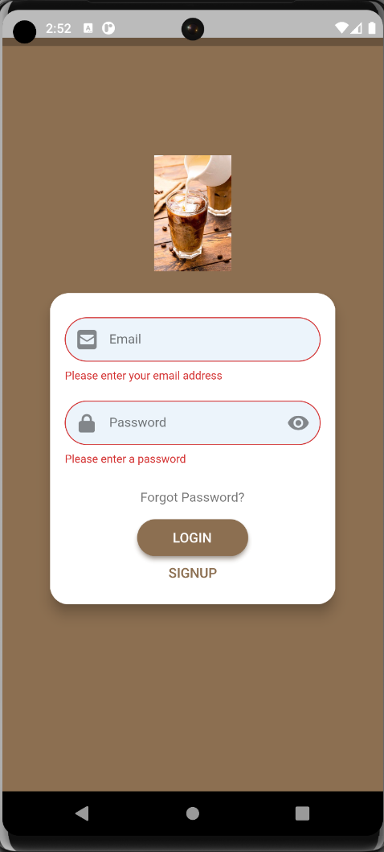
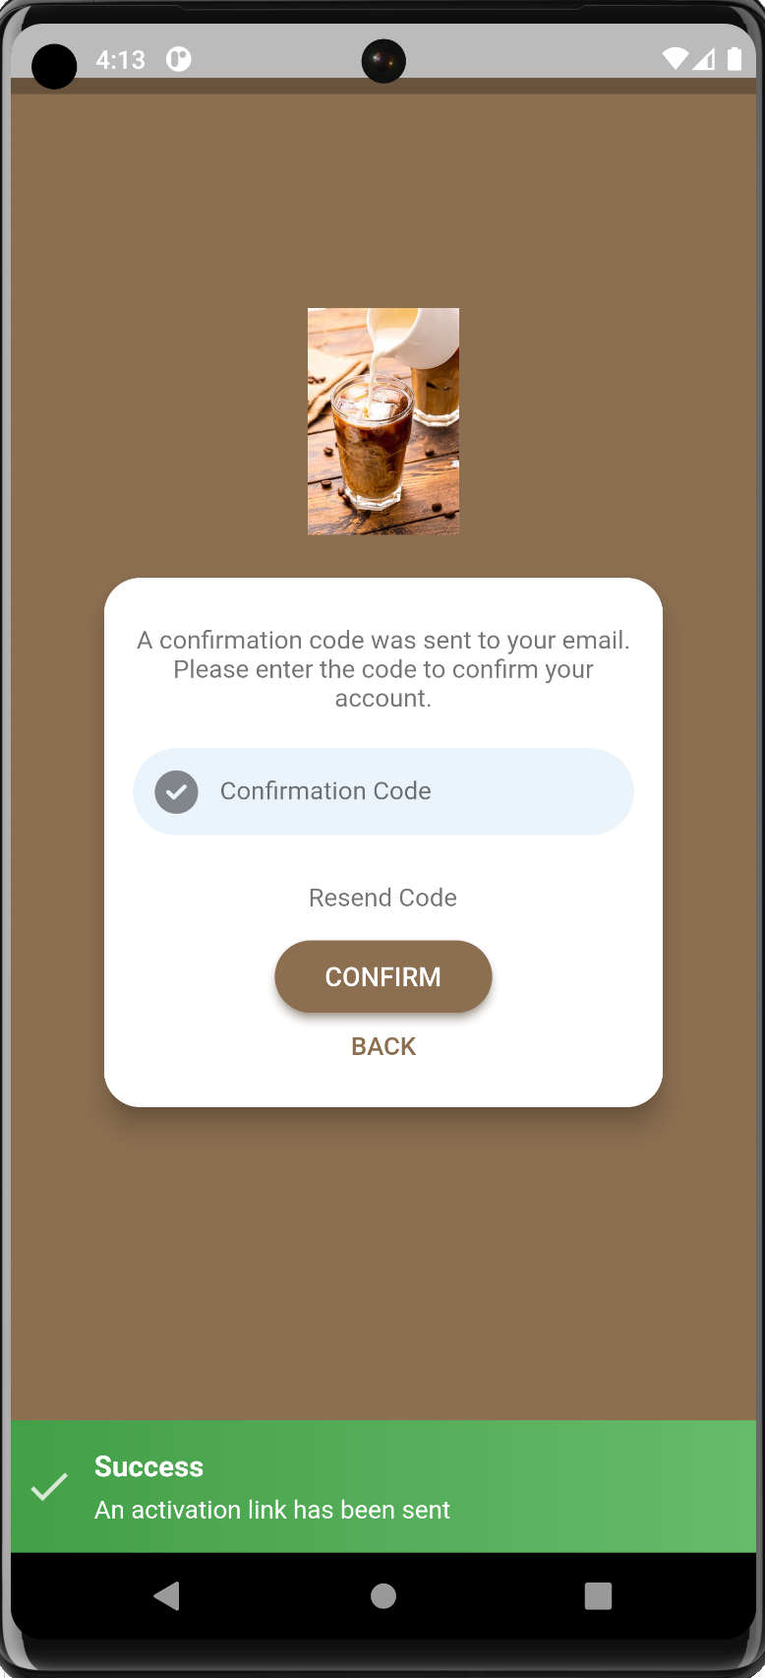
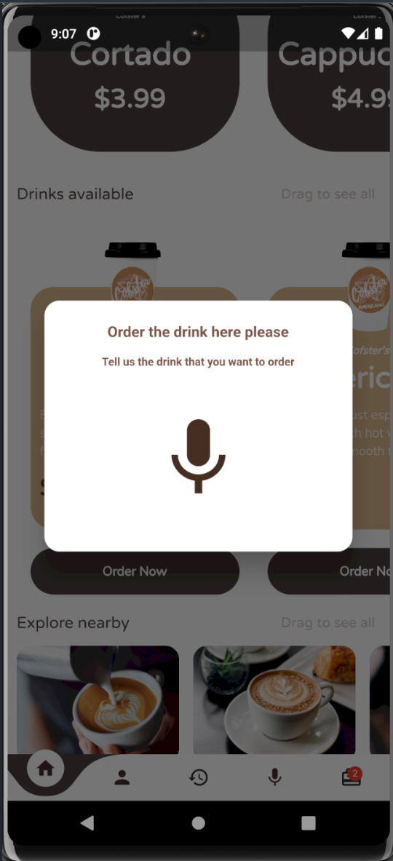
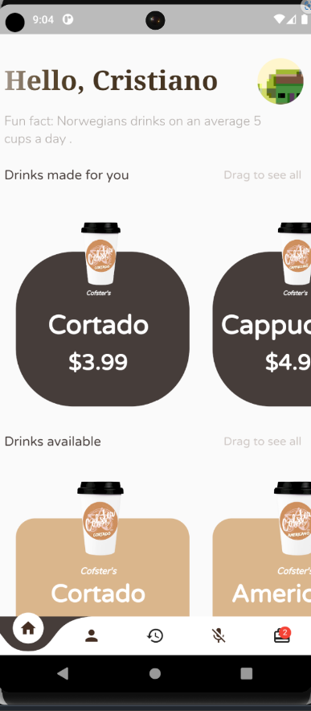
Mobile Application

Slide 7
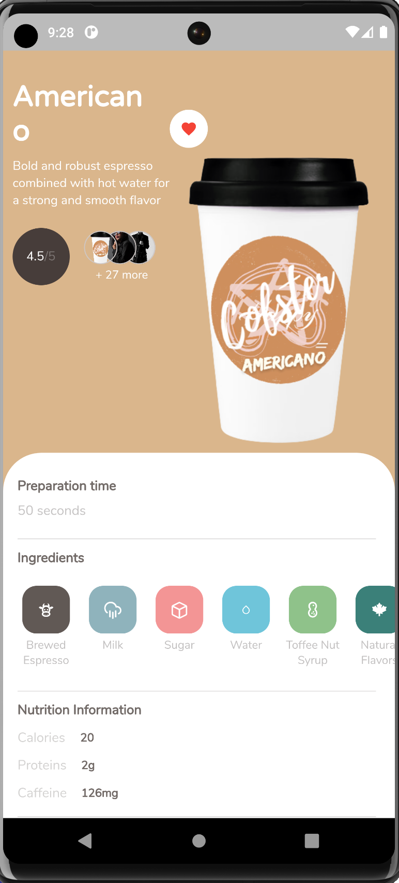
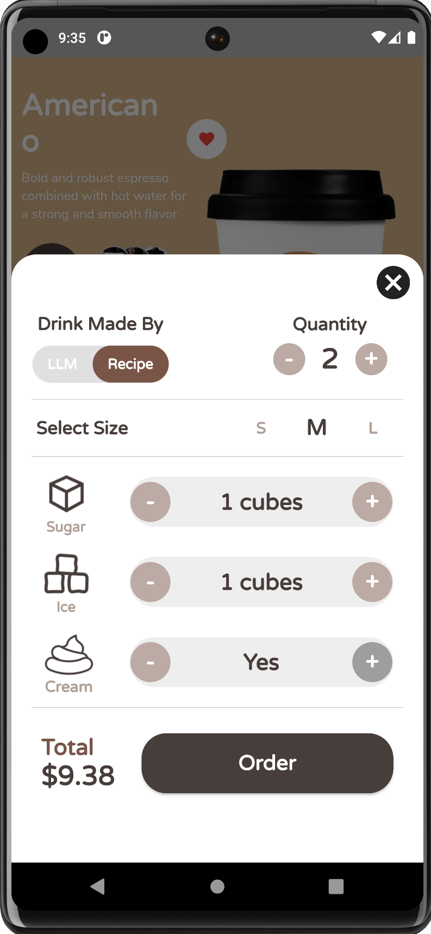
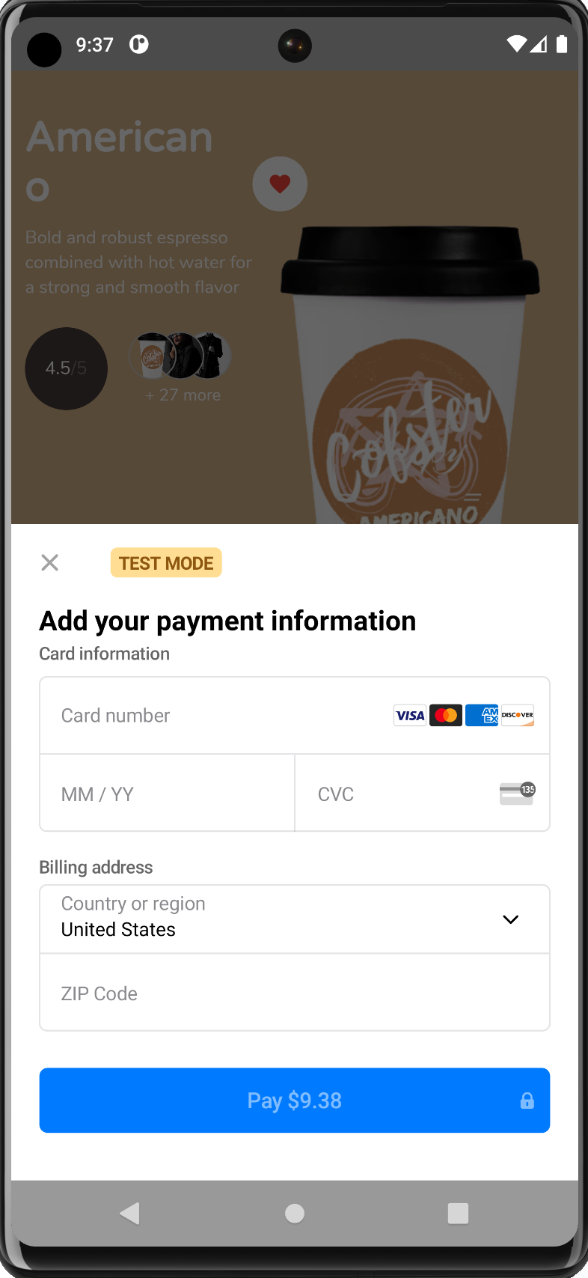
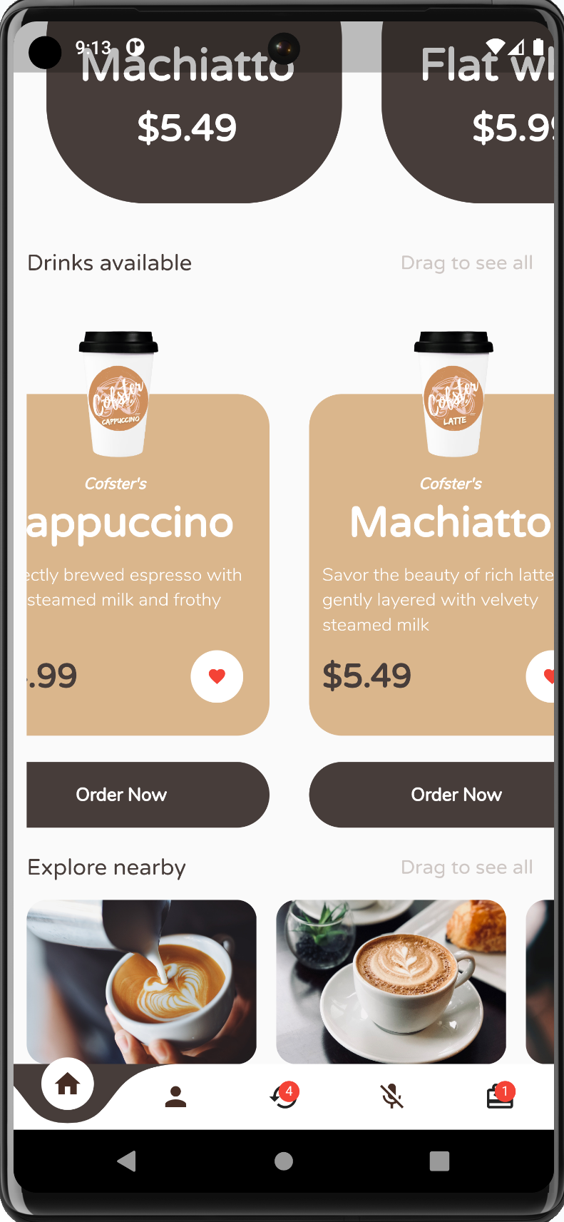
Mobile Application

Slide 8
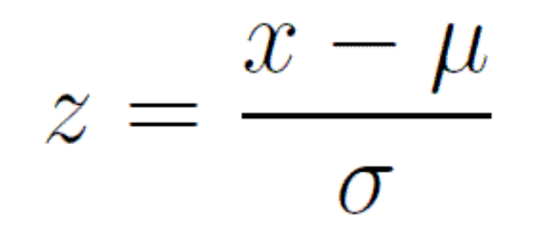
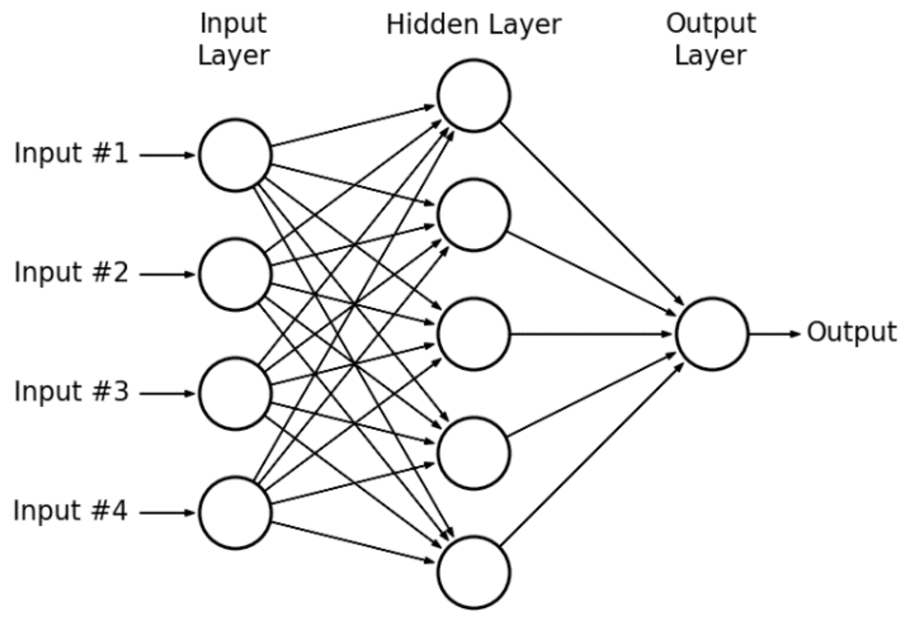
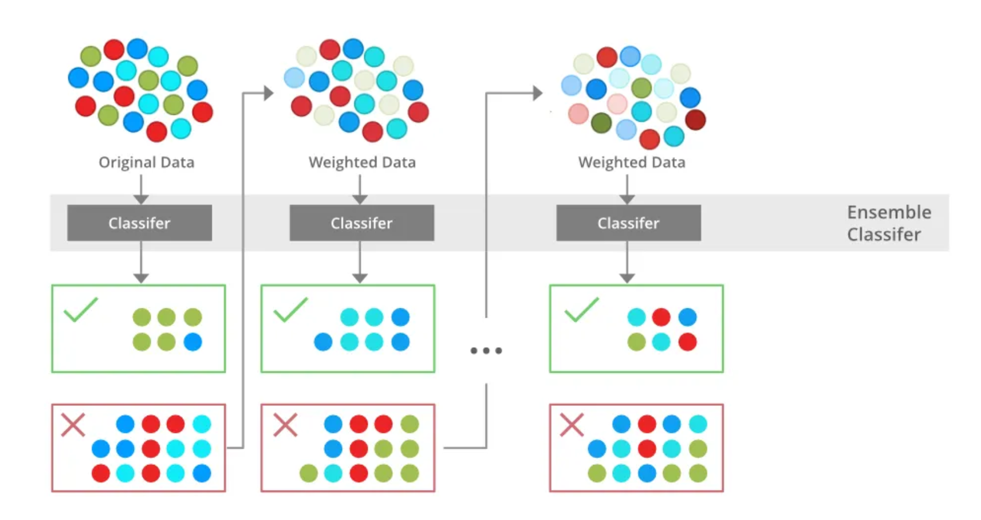
Coffee Recommender
Tabular data

Slide 9

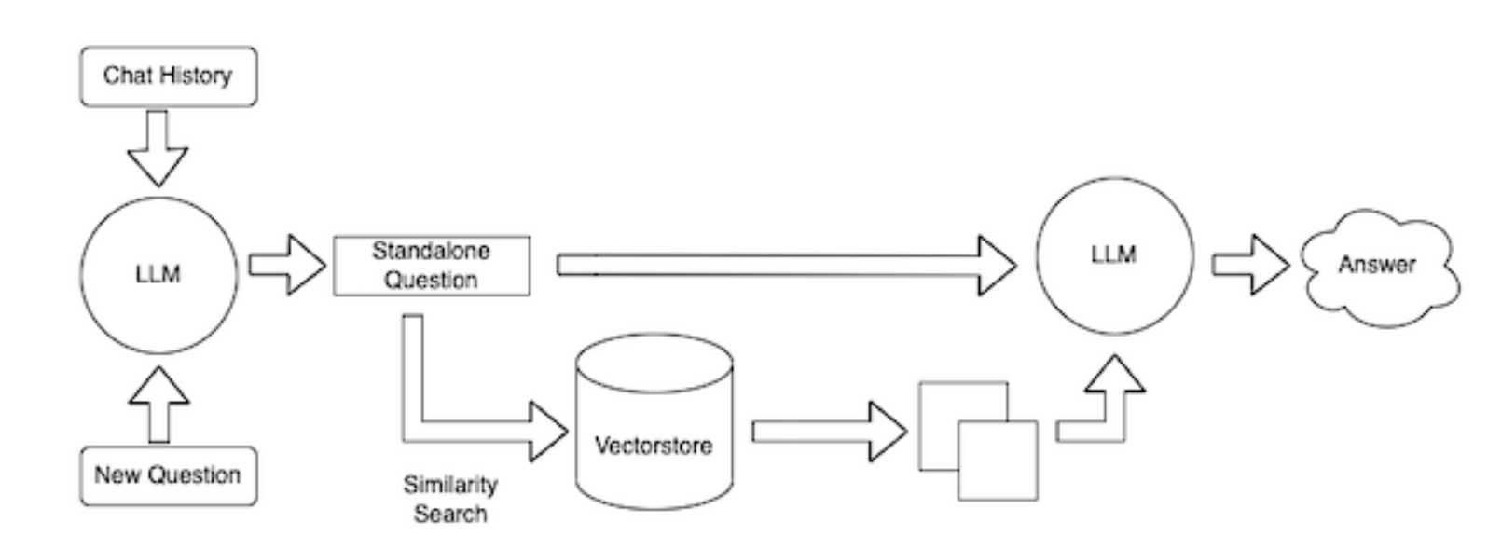
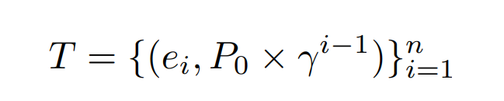
Autoregressive coffee creation
newer responses are more important (Bellman updater)

Slide 10
YOLO models training details
Freeze first 5 layers
Trained for 400 epochs, with early stopping enabled after 50
Batch size of 16
Dropout rate of 0.4
Weight decay is 0.01
Learning rate is set to 0.01
AdamW optimizer
Utilizes 16 workers for data loading

Slide 11
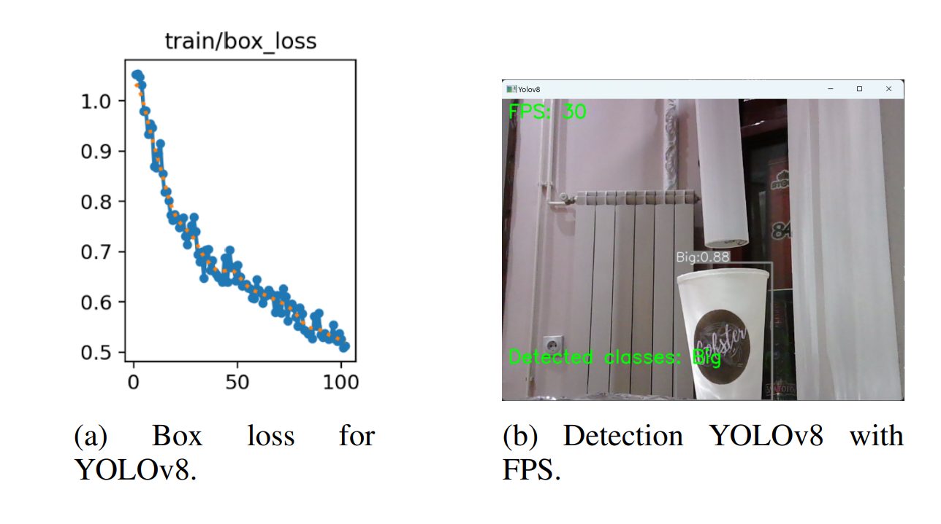
YOLOv8 Result

Slide 12
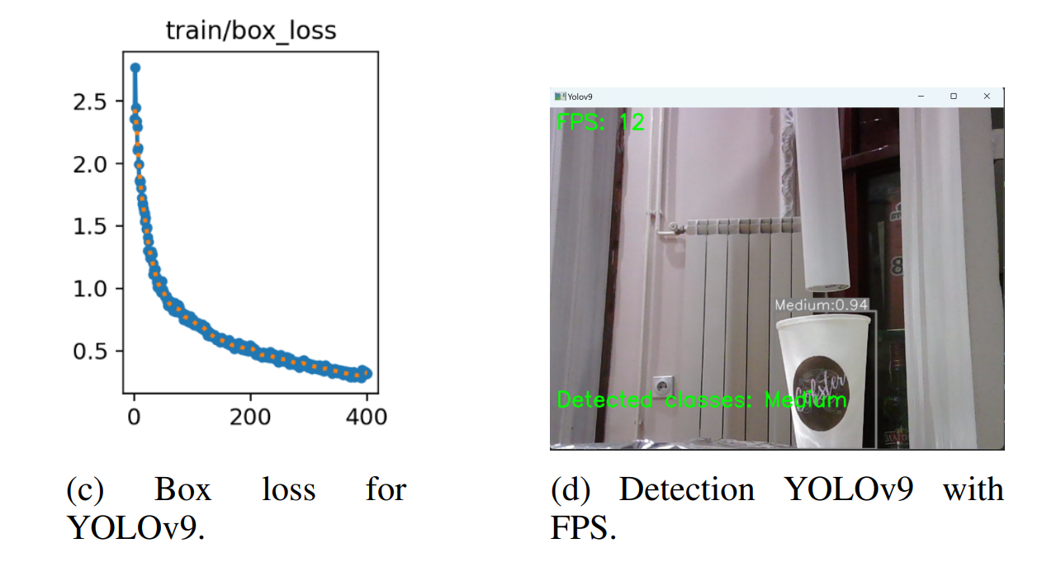
YOLOv9 Result

Slide 13
Conclusions
We propose an architectural framework for an intelligent coffee system utilizing cutting-edge technologies and modern system architectures.
We implemented a microservices-based backend architecture with a hybrid cloud deployment. This approach allows us to decouple components, enabling cup detection to be performed on a standard server rather than on an edge device.
For the autoregressive coffee creation, we utilized a Langchain agent with the RAG method, providing continuous context to the LLM. This allows for automatic updates to coffee recipes without human intervention.
Our results, for the task of custom cup detection, show an impressive 30 FPS, with a box loss of 0.50846, for the YOLOv8 model, and 12 FPS, with a box loss of 0.29018, for the YOLOv9 one.

Slide 14
References
S. Swain, A. Deepak, A. K. Pradhan, S. K. Urma, S. P. Jena, and S. Chakravarty, “Real-Time Dog Detection and Alert System using Tensorflow Lite Embedded on Edge Device,” in 2022 1st IEEE International Conference on Industrial Electronics: Developments & Applications (ICIDeA), 2022, pp. 238–24.
K. Tseng, “Predicting victories in video games: using single XGBoost with feature engineering: IEEE BigData 2021 Cup-Predicting Victories in Video Games,” in 2021 IEEE International Conference on Big Data (Big Data), 2021, pp. 5679–5682.
V. A. M. Luis, M. V. T. Quinones, and A. N. Yu- ˜ mang, “Classification of Defects in Robusta Green Coffee Beans Using YOLO,” in 2022 IEEE International Conference on Artificial Intelligence in Engineering and Technology (IICAIET), 2022, pp. 1–6.

Slide 15
Thank you!

